Slide 1
Mastering Process Improvement
with Hilary Corna

Slide 2
A
G
E
Segue 10:00-10:05 AM CST
Background 10:05-10:10 AM CST
The 3 Key Process Tools 10:10-10:40 AM CST
Putting Them into Action 10:45-10:50 AM CST
Questions 10:50-11:00 AM CST
N
D
A
JULY.24

Slide 3
What You’ll Learn Today...
01
02
03
The Importance of Process Excellence
Where to Start and the 8 Steps of the PDCA Process
How to Overcome Common Challenges along the Way

Slide 4
The Importance of
Process Excellence

Slide 5
The Importance of Process Excellence
Competitive advantage in a dynamic market
Companies with mature operational excellence programs achieve 23% higher profitability and 19% faster revenue growth compared to their peers.
Accenture report (2023)

Slide 6
The Importance of Process Excellence
Customer Satisfaction
88% of consumers are more likely to return to a business after a positive customer experience. Process excellence directly impacts efficiency, responsiveness, and overall satisfaction.
McKinsey Global Institute report (2021)

Slide 7
The Importance of Process Excellence
Agility and Adaptability
The ability to adapt quickly and efficiently to changing market dynamics is a key driver of success in the 21st century. Process excellence fosters a culture of continuous improvement and innovation. World Economic Forum report (2023)

Slide 8
The Importance of Process Excellence
Employee Engagement and Productivity
Employees who understand and are involved in process improvement initiatives are 27% more engaged and productive.
Gallup Global Workplace Report (2023)

Slide 9
Problems with Current Approaches
They’re too BIG (Enterprise level)
They’re too complex
They’re not designed for non-manufacturing businesses
They’re a lot of wasted time in unproductive meetings
They’re mostly focused on “documentation”

Slide 10
THE 3 KEY PROCESS TOOLS

Slide 11
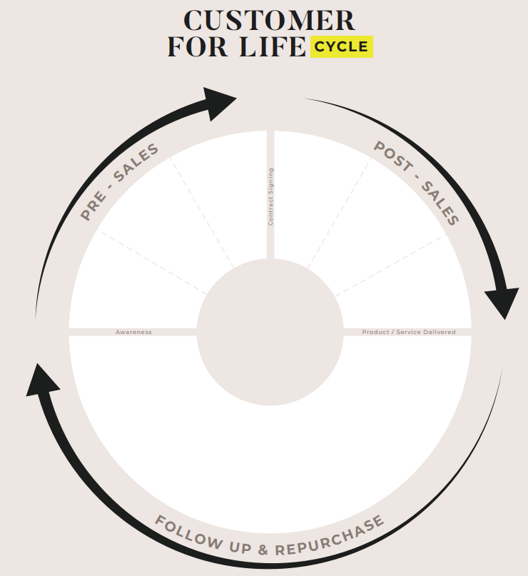
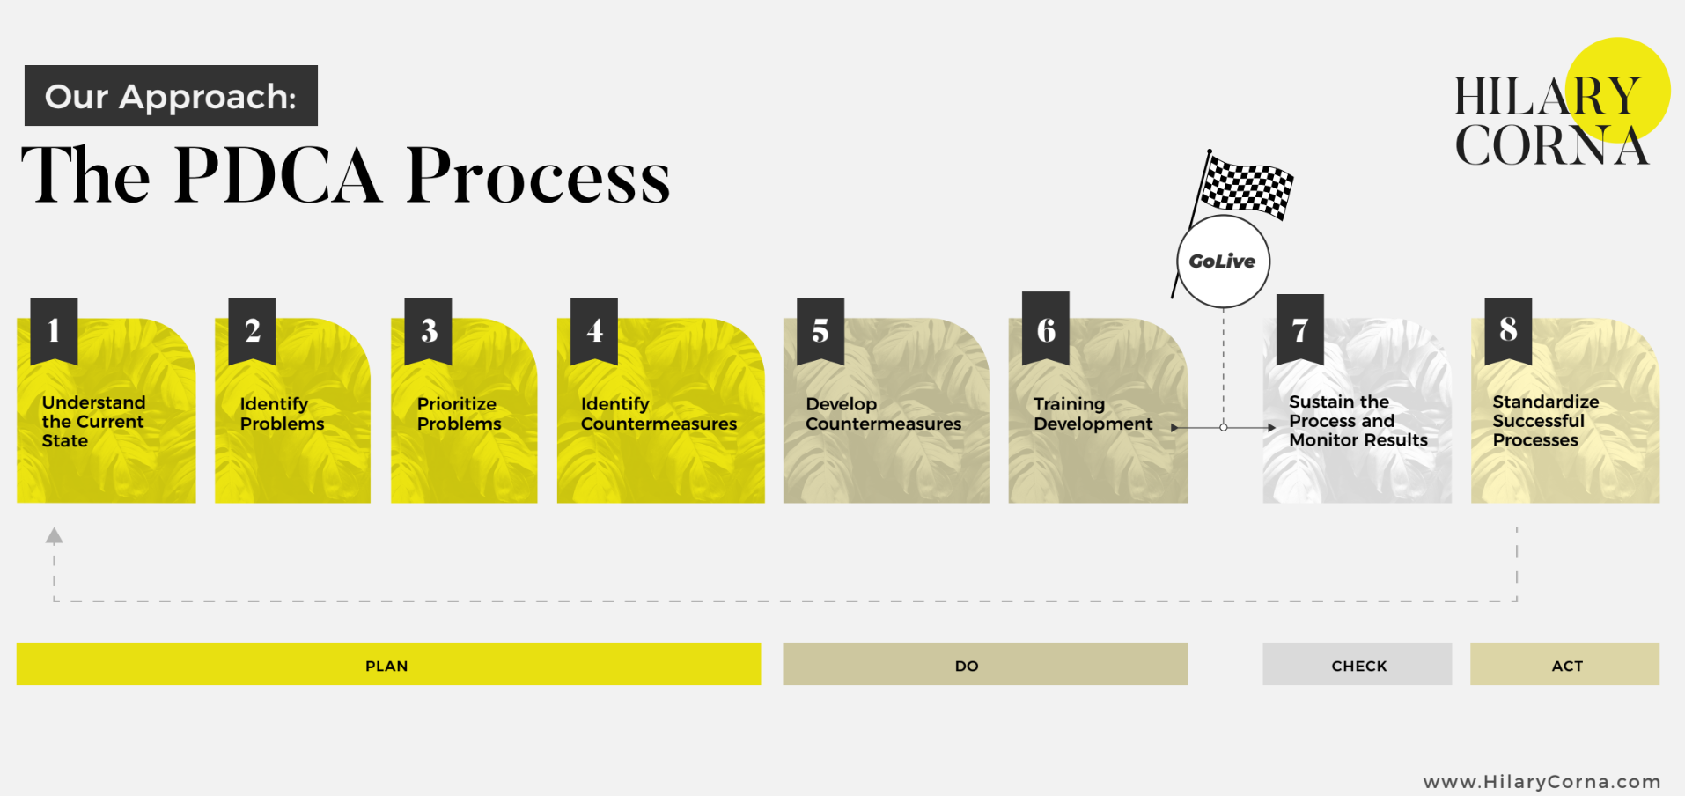
HILARY CORNA HILARY CORNA HILARY CORNA HILARY CORNA
HILARY CORNA HILARY CORNA
3 KEY PROCESS TOOLS
Goods & Information Flow
PDCA
Customer For Life Cycle

Slide 12
HILARY CORNA HILARY CORNA HILARY CORNA HILARY CORNA
HILARY CORNA HILARY CORNA
3 KEY PROCESS TOOLS
The How
The What
The Why

Slide 13
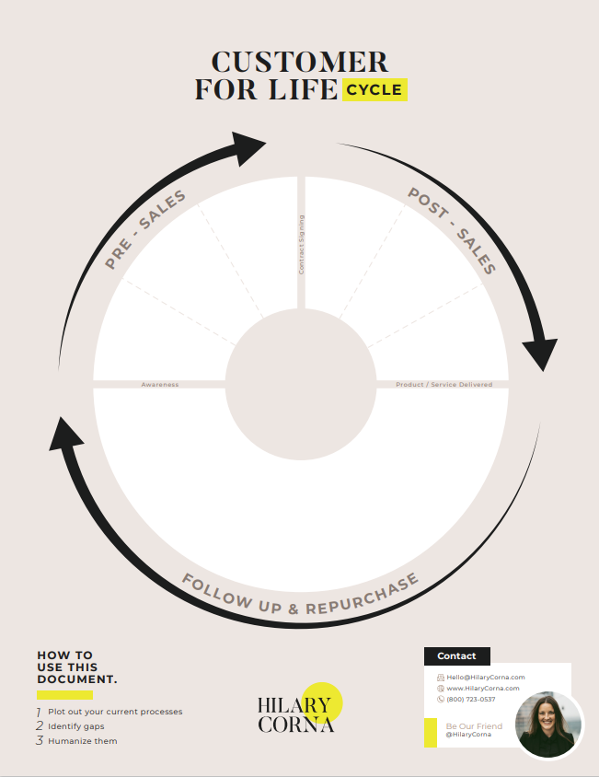
The WHY
A more sustainable and predictable business
Earn the right to Customers For Life
Develop a hidden strategic advantage
Notes:
Trello
Group work

Slide 14
Notes:
Trello
Group work

Slide 15
Moving Forward
Plan
Action
Do
Check
PDCA WHEEL

Slide 16
The Strategy
Rollout Version Control
Start with a V.1
Each additional PDCA cycle reduces in time
Just like a phone rolls out software updates in bulk, GoLive with process updates in bulk
Over time, this standardization creates your company “Way”
PDCA STEPS

Slide 17
The Kaizen Strategy
Why?
Not all problems can be solved in V.1
Not all problems are equal in importance or urgency
Not aiming for temporary fixes
Not erratically “taking action” that causes disruption, disjointed change and un-sustained processes

Slide 18
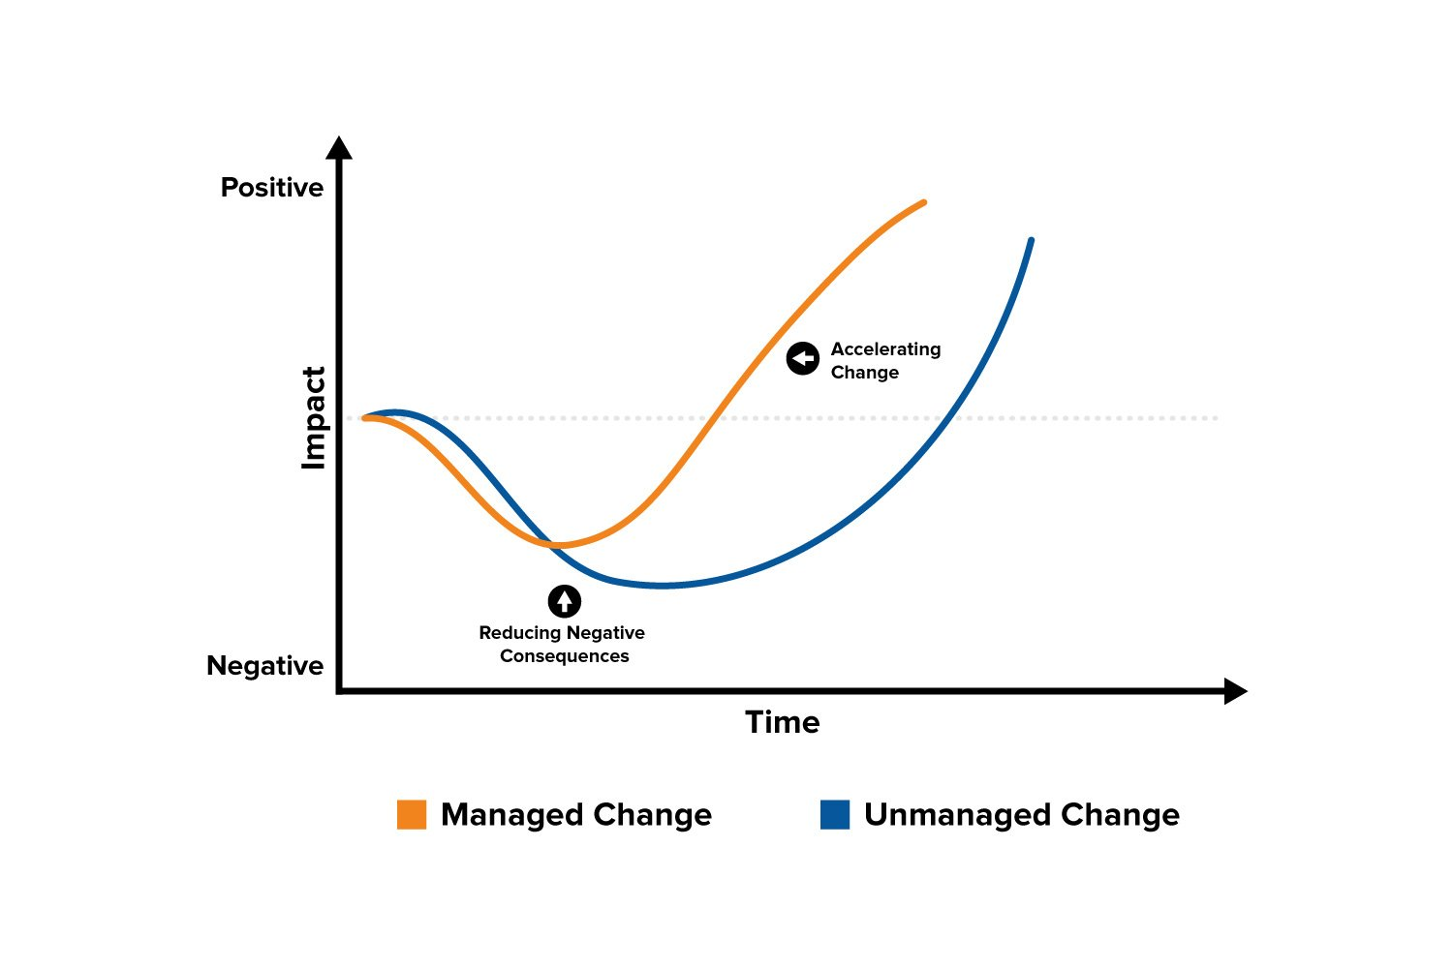
THE
HUMAN
WAY

Slide 19
Notes:
Trello
Group work

Slide 20
Goods & Information Flow
Pre-Sales
Post-Sales
FU/Repurchase
PROCESS MAPPING

Slide 21
Goods & Information Flow
Defined:
A one page master flow chart method across all department touchpoints that visually depicts the sequence of goods and information in a planned business process from end to end.
PROCESS MAPPING

Slide 22
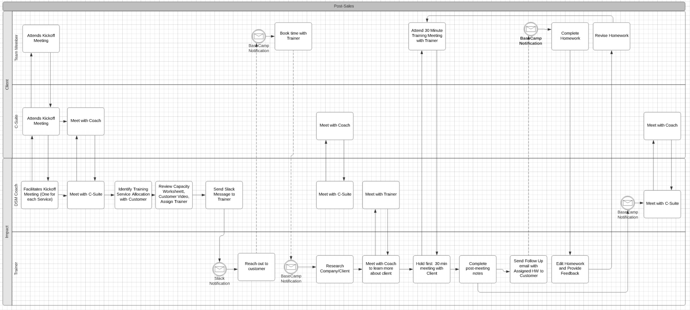
Goods & Information Flow
WHO
(Y-AXIS)
WHEN
(X-AXIS)
WHAT
(TASKS)
PROCESS MAPPING

Slide 23
What makes a Goods & Information Flow different?
It is sequential in time
It includes the customer perspective
It shows cross-functional dependencies
It shows what is happening, now how its happening
There is only one per company
PDCA STEPS

Slide 24
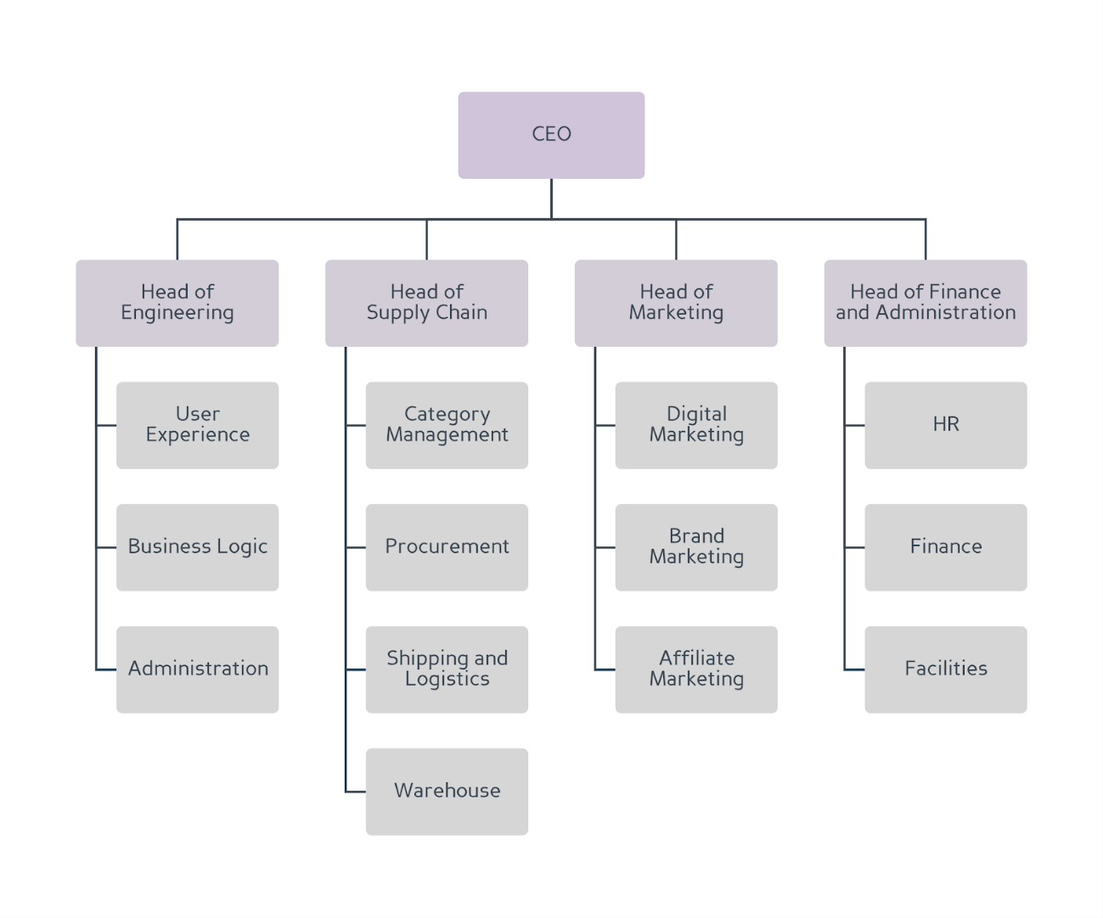
CYCLICAL OPERATIONS
Not aware of what others are doing
Difficult to know when one dept changes
Only some connected to the customer
Creates inconsistent experiences
More “finger-pointing”
Syncs departments
More effective initiatives
Less disjointed processes
Highly empathetic
More gaps surface faster
More objective
Depersonalized

Slide 25
Notes:
Trello
Group work

Slide 26
NO ONE HAS MORE TROUBLE THAN THE PERSON WHO CLAIMS TO HAVE NO TROUBLE
-Taiichi Ohno

Slide 27
DEFINITION OF “PROBLEM”
//
Ideal
Situation
Gap = Problem
Current Situation

Slide 28
Problem Prioritization
Steps 3 – 8: Identify and Prioritize Problems to Standardize Successful Processes:
We use one master worksheet for each step

Slide 29
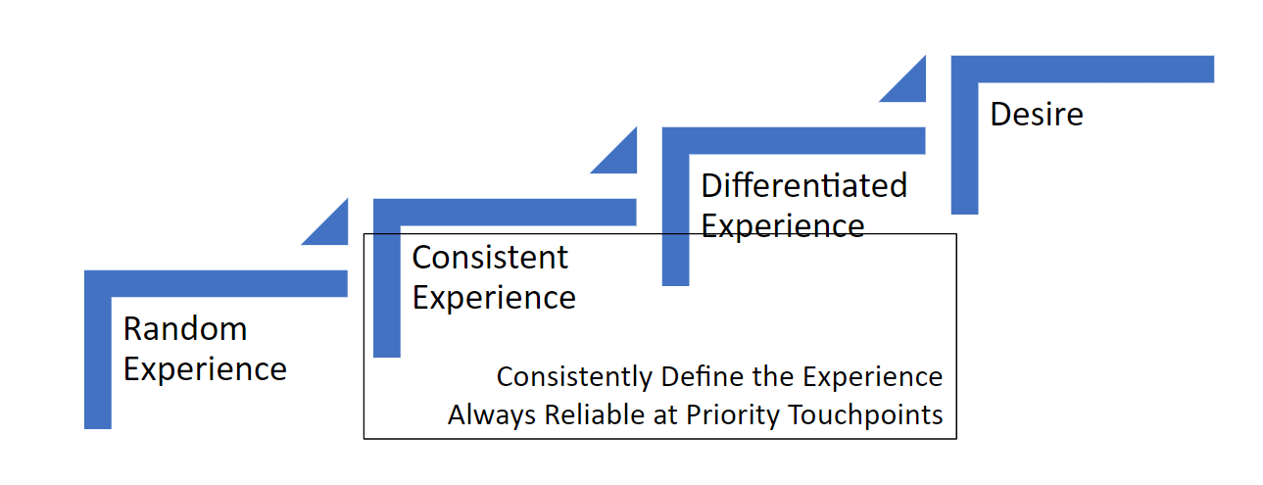
PROCESS MAPPING

Slide 30
Notes:
Trello
Group work

Slide 31
HILARY CORNA HILARY CORNA HILARY CORNA HILARY CORNA
HILARY CORNA HILARY CORNA
3 KEY PROCESS TOOLS
Goods & Information Flow
PDCA
Customer For Life Cycle

Slide 32
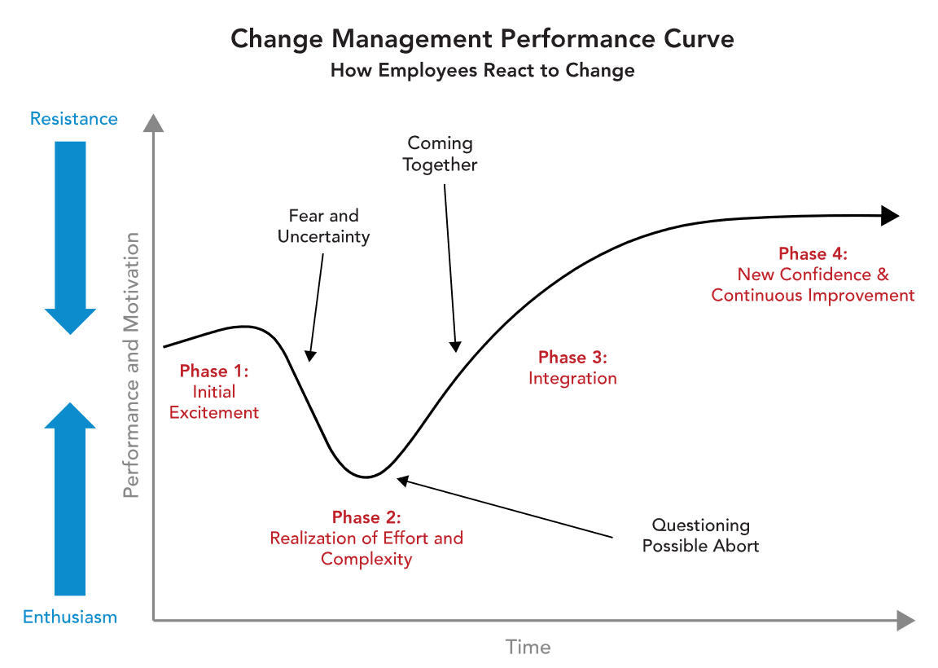
The Employee Experience

Slide 33
The Employee Experience

Slide 34
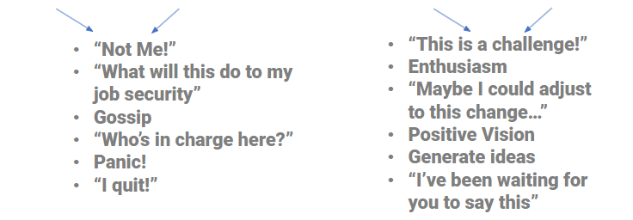
The Employee Experience

Slide 35
IT’S NOT WHAT WE CHANGE. IT’S HOW WE CHANGE.
-Hilary Corna

Slide 36
What You Learned Today...
01
02
03
The Importance of Process Excellence
Where to Start and the 8 Steps of the PDCA Process
How to Overcome Common Challenges along the Way

Slide 37
HIL ARY CORNA HILARY CORNA HILARY CORNA HILARY CORNA
HILARY CORNA HILARY CORNA
3 KEY PROCESS TOOLS
Goods & Information Flow
PDCA
Customer For Life Cycle

Slide 38
THANK YOU!
Hilary@HilaryCorna.com

