Slide 1
Leah Cordovez, MD, FACP
Be Well & Flourish treats the WHOLE person using evidence-based medicine and an integrative approach to physical, mental and emotional health.
Private Membership-based Healthcare
Primary Care
Consulting Services on COVID Guidance & Employee Health and Wellness
Bewellandflourish.com
member@bewellandflourish.com

Slide 2
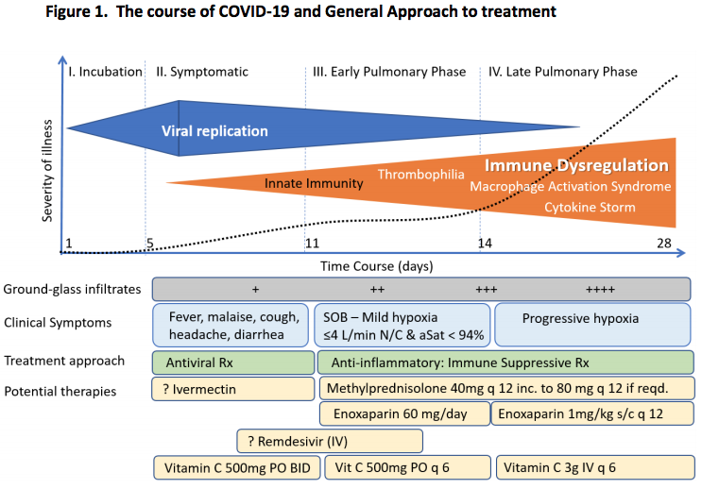
Developed and updated by Paul Marik, MD
Chief of Pulmonary and Critical Care Medicine
Eastern Virginia Medical School, Norfolk, VA
www.evms.edu/covid-19/covid_care_for_clinicians/

Slide 3
Prophylaxis
Vitamin C 500 mg twice a day
Quercetin 250-500 mg twice a day
Zinc (lozenges) 25 -50 mg daily
Melatonin (slow release) 0.3 -2 mg at bedtime
Vitamin D 2000-4000 IU daily
Famotidine 20-40 mg daily
Bewellandflourish.com
member@bewellandflourish.com

Slide 4
Symptomatic COVID at home
All of the above plus:
Ivermectin (weight based dosing)
Aspirin or low molecular weight heparin
(both are Rx)
Primum non nocere…..
Bewellandflourish.com
member@bewellandflourish.com

